Slide 1

Data Abstraction, Data Model & Database Language

Slide 2
Topic of Discussion
Data Abstraction
Instance and Schema
Data Model
Data language

Slide 3
Data abstraction
Data abstraction is hiding the complex data structure in order to simplify the user’s interface of the system.
Data abstraction allow developers to keep complex data structures away from the users through levels of abstraction.

Slide 4
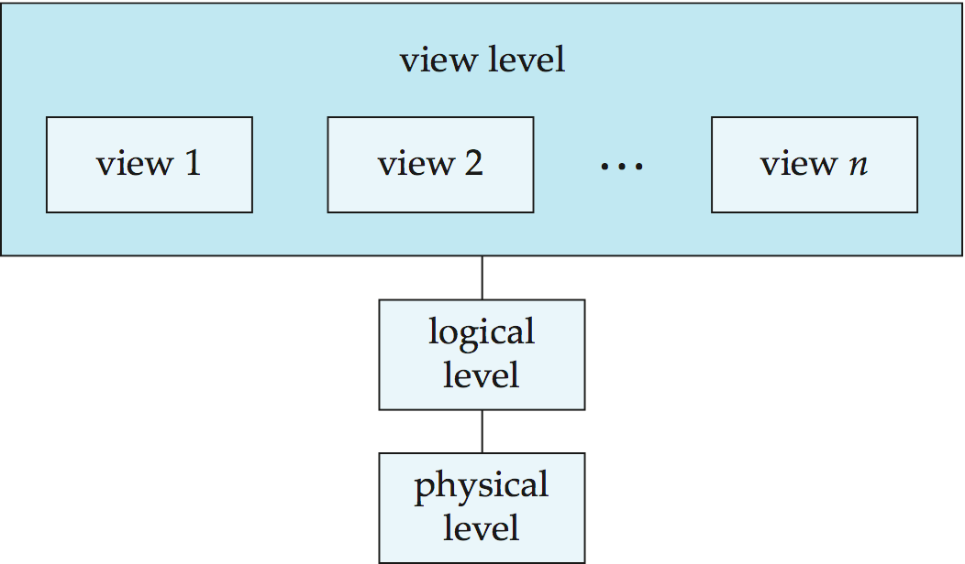
Three level of data abstraction or Three schema Architecture
User
(external level)
( Conceptual level)
(Internal level)
database

Slide 5
View level or external level
It is the highest level of data abstraction and exhibits only a part of the whole database.
It exhibits the data in which the user is interested.
The view level can describe many views of the same data.

Slide 6
Logical level or Conceptual level
In logical level, the data is stored in the form of the entity set, entities, their data types, the relationship among the entity sets, user operations performed to retrieve or modify the data and certain constraints on the data.

Slide 7
Physical or Internal level
The physical or the internal level schema describes how the data is stored in the hardware.
It also describes how the data can be accessed.
The physical level shows the data abstraction at the lowest level and it has complex data structures.
Only the database administrator operates at this level.

Slide 8
Instances and Schemas
Logical Schema – the overall logical structure of the database
Example: The database consists of information about a set of customers and accounts in a bank and the relationship between them
Analogous to type information of a variable in a program
Physical schema– the overall physical structure of the database
Instance – the actual content of the database at a particular point in time

Slide 9
Data Model
A Database model defines the logical design and structure of a database and defines how data will be stored, accessed and updated in a database management system.
Relational model
Entity-Relationship data model (mainly for database design)
Object-based data models (Object-oriented and Object-relational)
Semistructured data model (XML)
Other older models:
Network model
Hierarchical model

Slide 10
SQL
SQL stands for Structured Query Language
SQL is a standard language for accessing and manipulating databases.
SQL commands are instructions. It is used to communicate with the database.
SQL can perform various tasks, like- create a table, add data to tables, drop the table, modify the table, set permission for users.

Slide 11
Types of SQL Commands
There are five types of SQL commands:
DDL (Data Definition Language)
DML (Data Manipulation Language)
DCL (Data Control Language)
TCL (Transection Control Language )
DQL (Data Query Language)

Slide 12
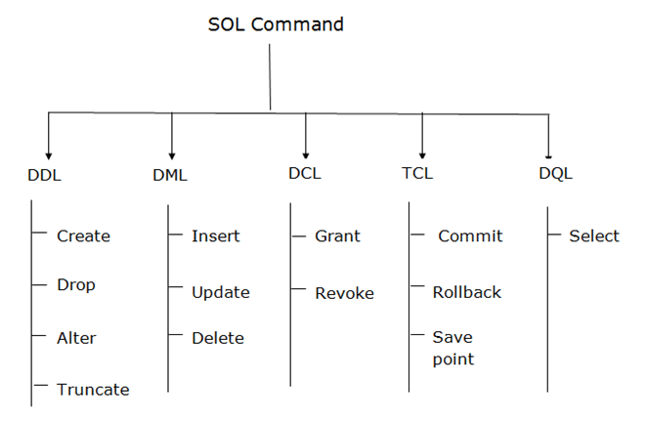
Types of SQL Commands

Slide 13
DDL
Examples of DDL commands:
CREATE – is used to create the database or its objects (like table, index, function, views, store procedure and triggers).
DROP – is used to delete objects from the database.
ALTER-is used to alter the structure of the database.
TRUNCATE–is used to remove all records from a table, including all spaces allocated for the records are removed.
COMMENT –is used to add comments to the data dictionary.
RENAME –is used to rename an object existing in the database.

Slide 14
DML
Examples of DML:
INSERT – is used to insert data into a table.
UPDATE – is used to update existing data within a table.
DELETE – is used to delete records from a database table.

Slide 15
DCL
Examples of DCL:
GRAND – It is used to give user access privileges to a database.
REVOKE – It is used to take back permissions from the user.

Slide 16
TCL
Examples of DCL:
COMMIT – Commit command is used to save all the transactions to the database.
ROLLBACK– Rollback command is used to undo transactions that have not already been saved to the database.
SAVEPOINT– It is used to roll the transaction back to a certain point without rolling back the entire transaction.

Slide 17
DQL
Examples of DCL:
SEARCH – It is used to select the attribute based on the condition described by WHERE clause.

Slide 18
Thank you

